Slide 1


Joint BAC Meeting
November 3, 2023

Slide 2

Agenda
Tour with Finding the Flint
Announcements
  2023 Water Reflections Calendar Contest Winners
  Website Update and Walkthrough
  2024 Water Drop Dash 5K
  Water Supply Update
Flint & Ocmulgee Chair Elections

Slide 3

2023 Water Reflections
Calendar Contest
Month-by-month winners

Slide 4


Slide 5
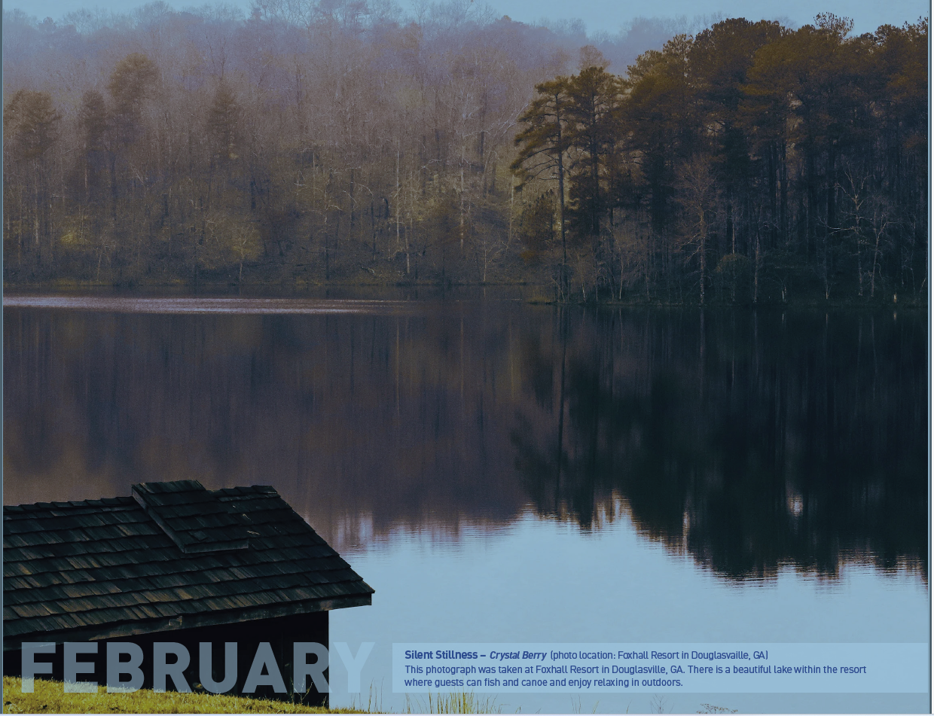

Slide 6
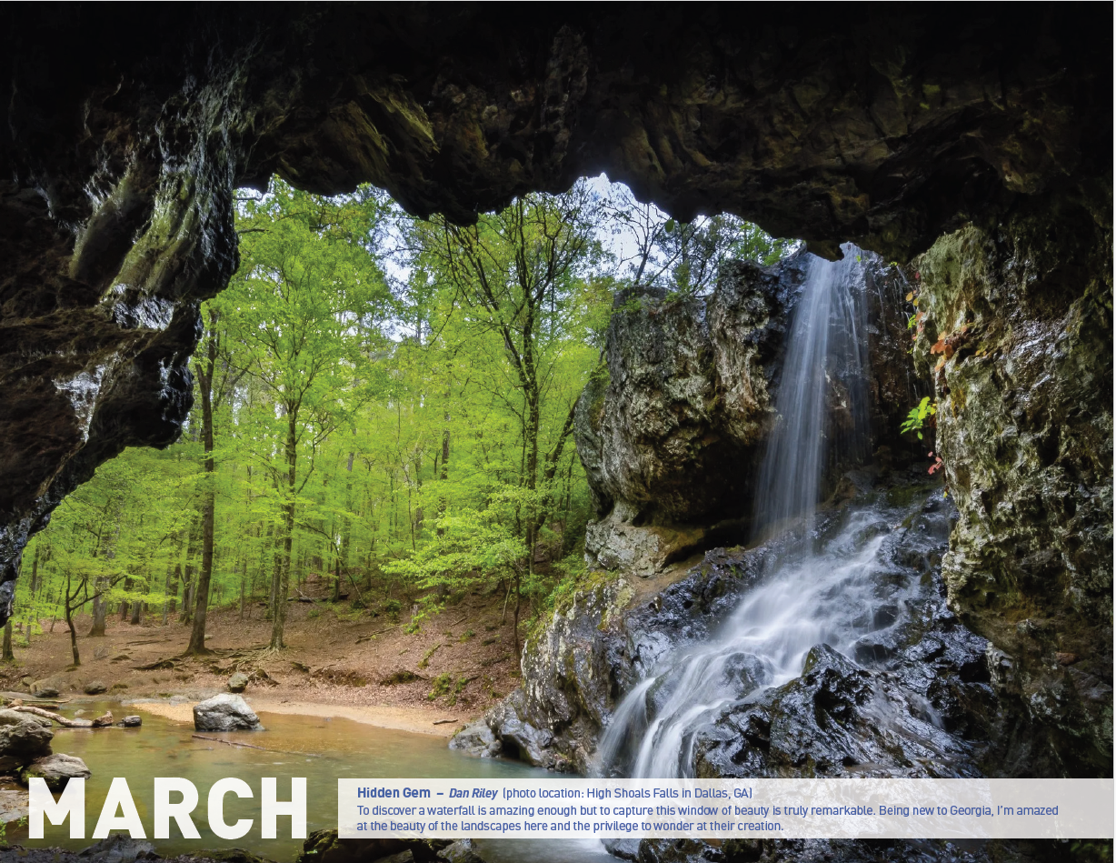

Slide 7
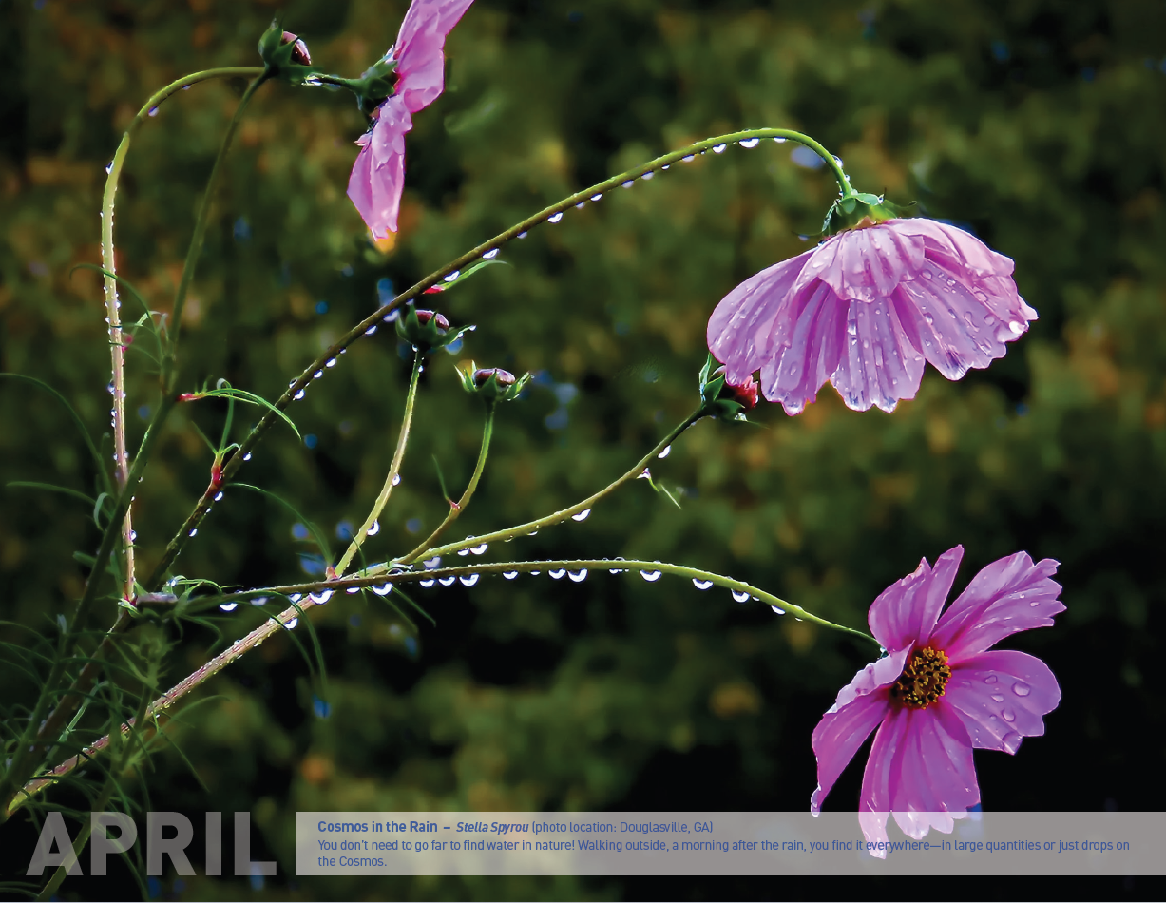

Slide 8


Slide 9
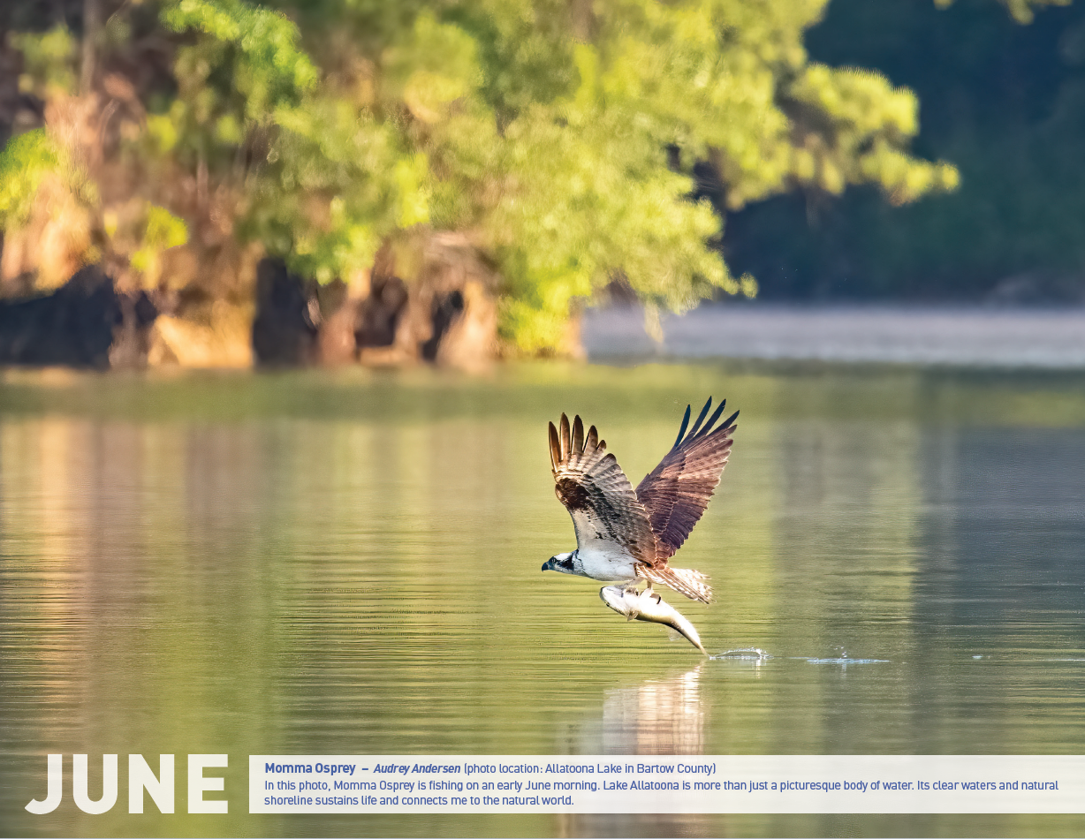

Slide 10


Slide 11


Slide 12


Slide 13


Slide 14
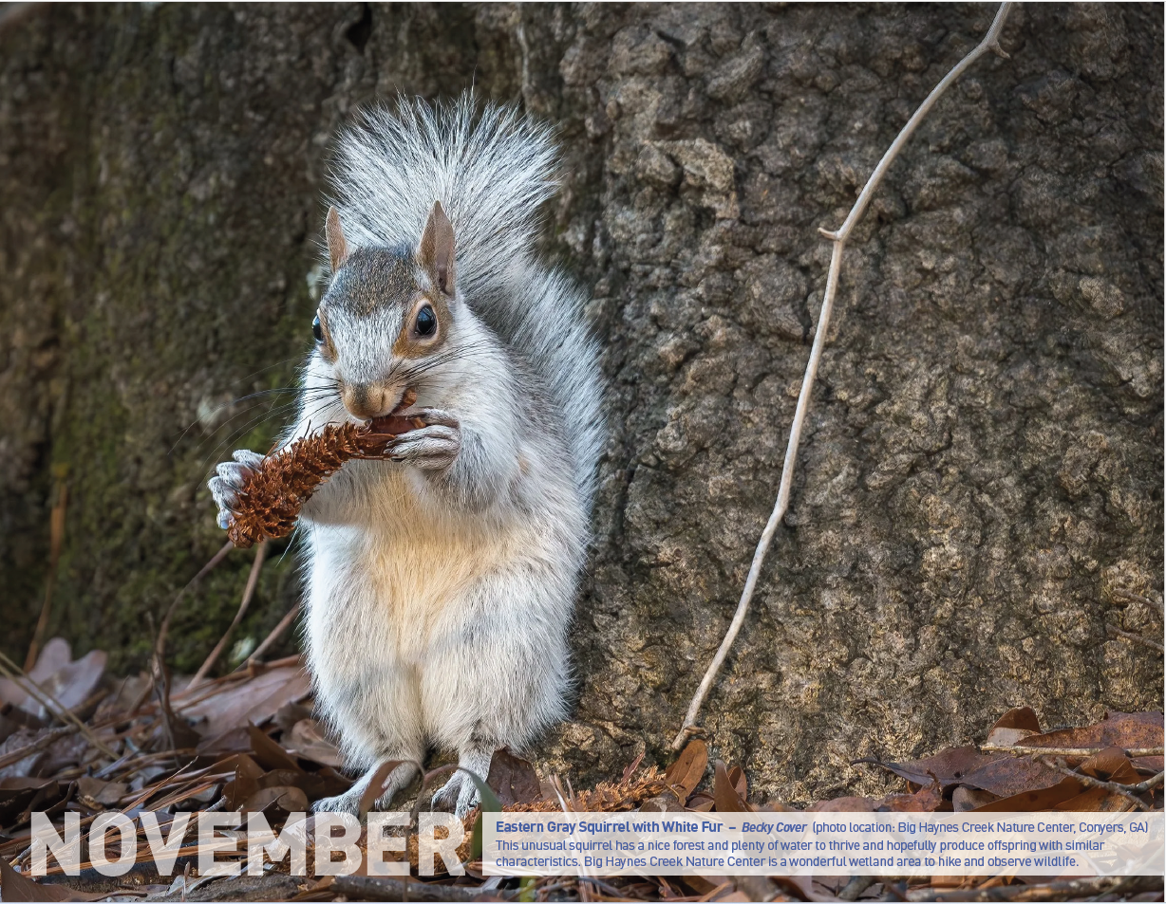

Slide 15


Slide 16
New District Website Features

Slide 17
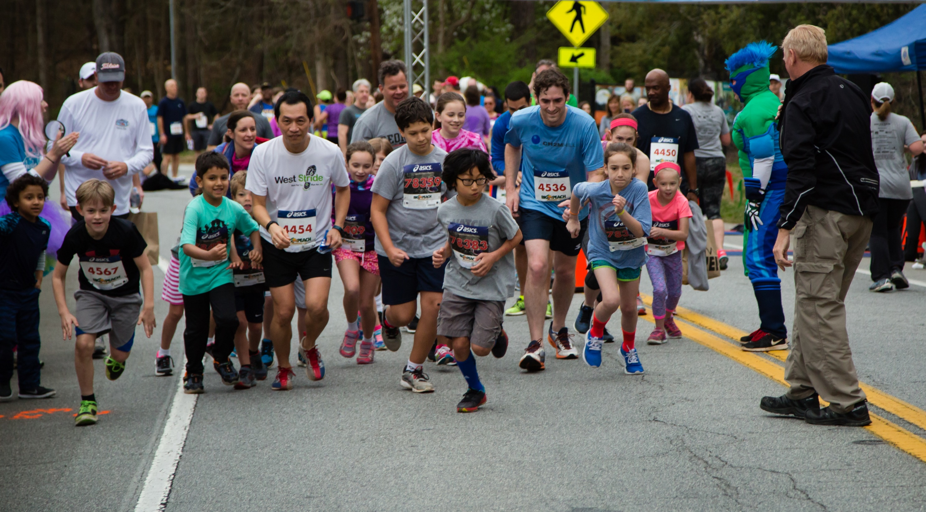
Saturday, March 16, 2024 at the Chattahoochee Nature Center

Slide 18
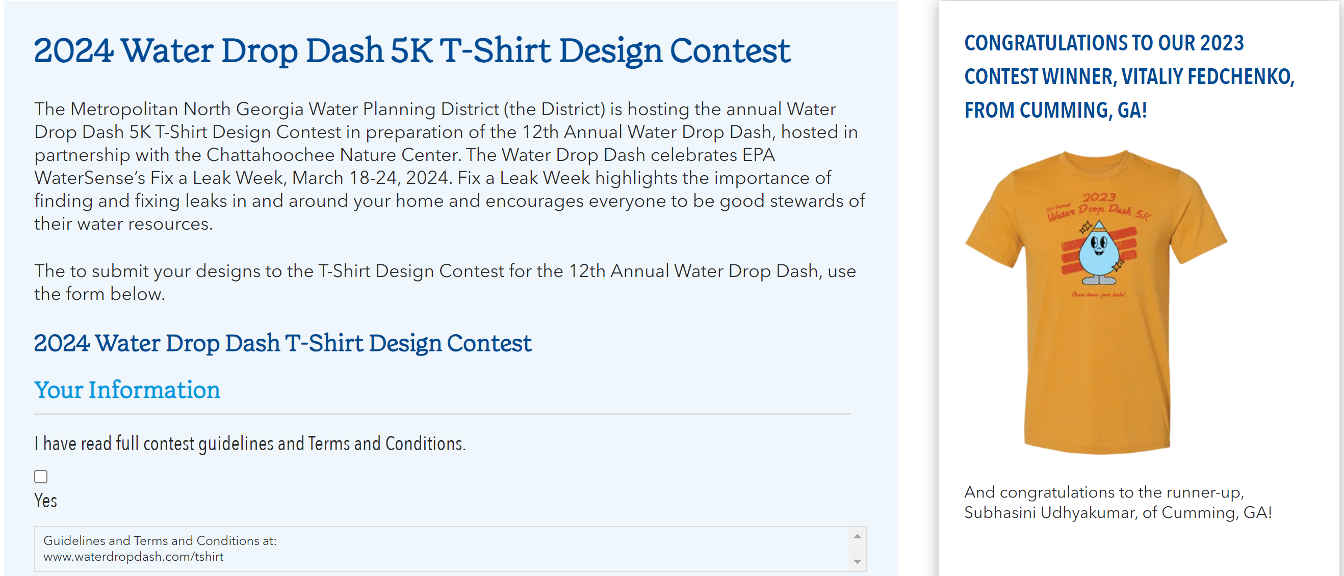

Slide 19
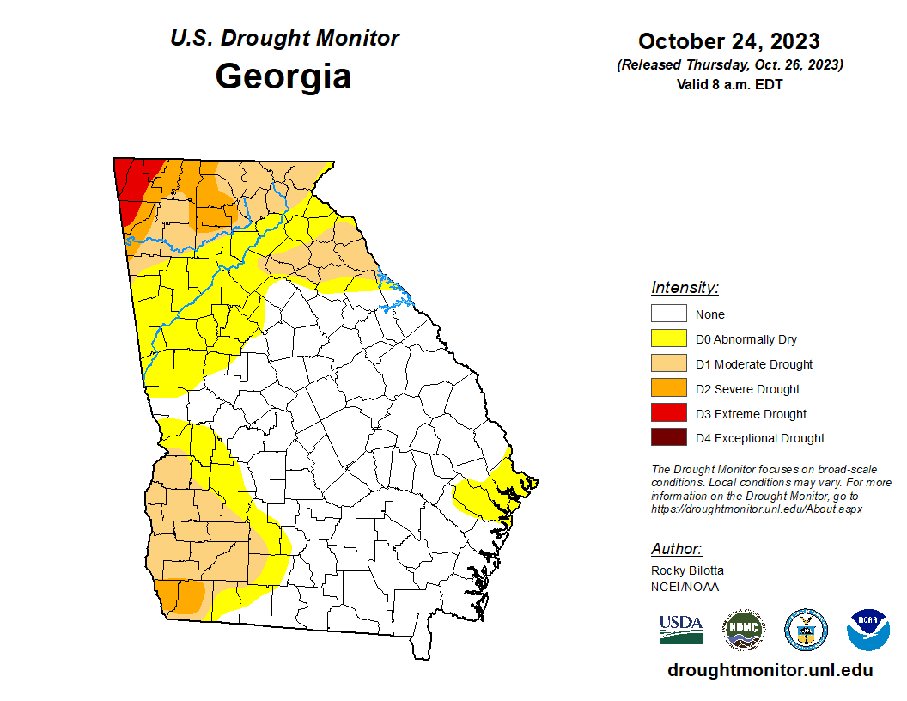
Drought Status

Slide 20
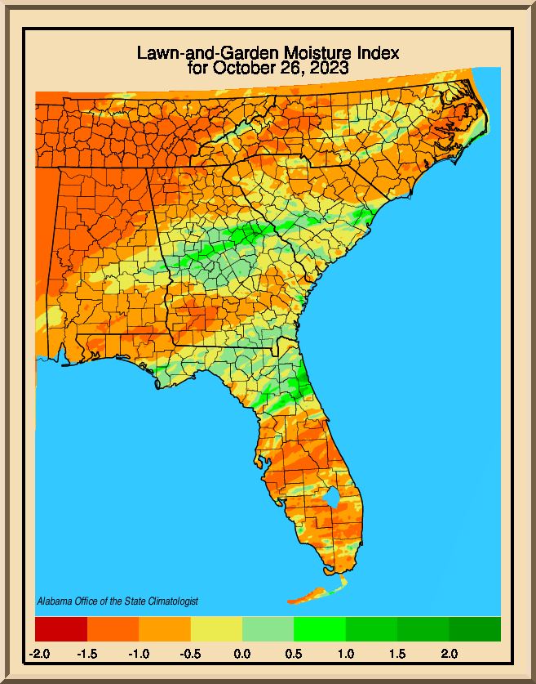
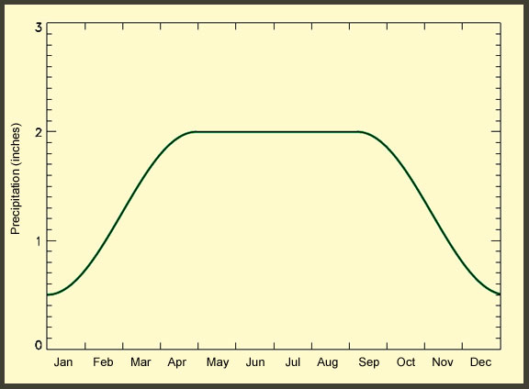
Moisture Index

Slide 21
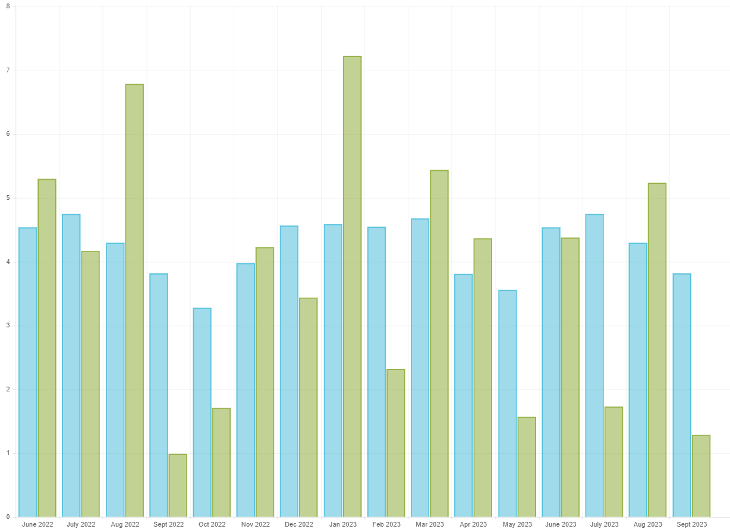


Rainfall in Metro Atlanta

Slide 22
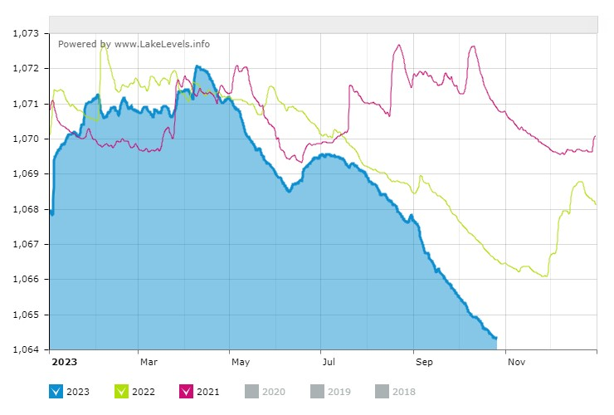
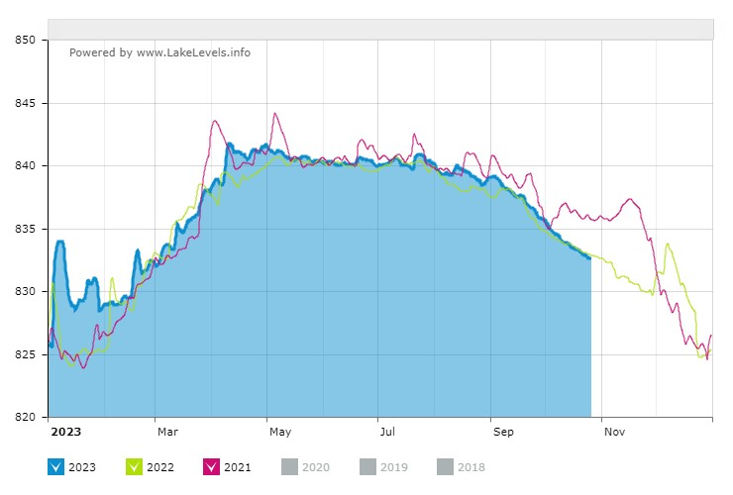
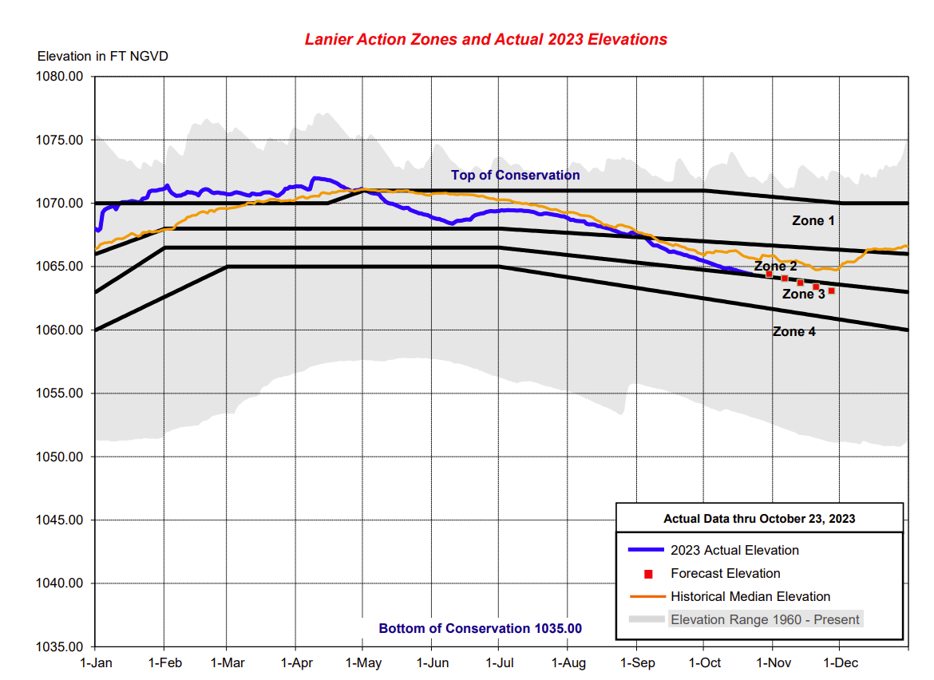
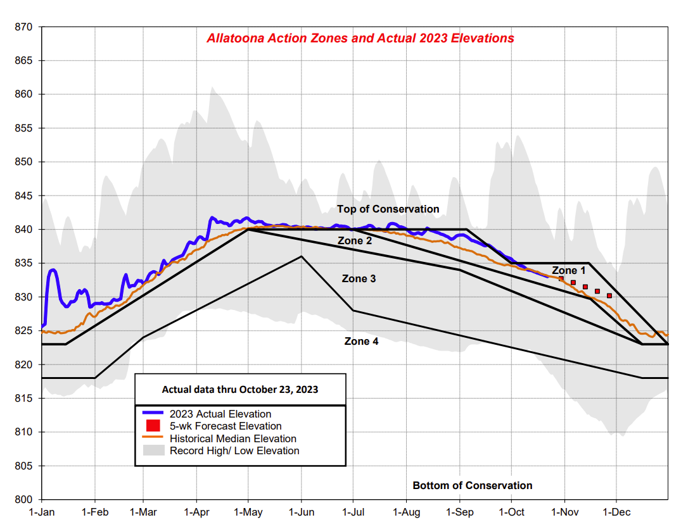
Lake Lanier (10/26)
1064.31’
Allatoona Reservoir (10/26)
832.60’
Full pool elev. – 1071’
Full pool elev. – 835’

Slide 23
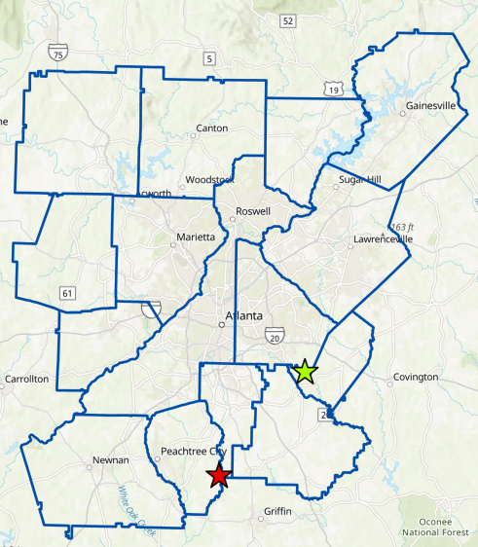
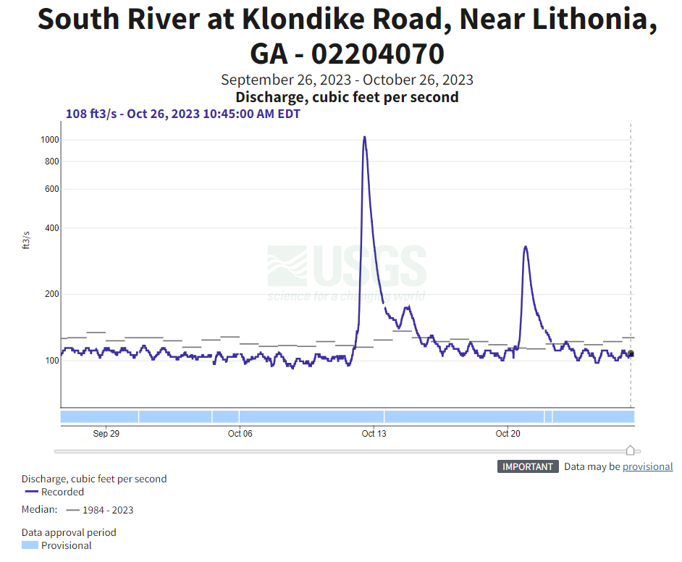
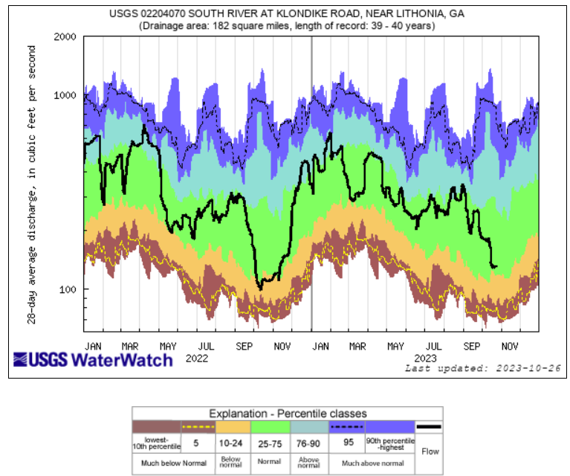
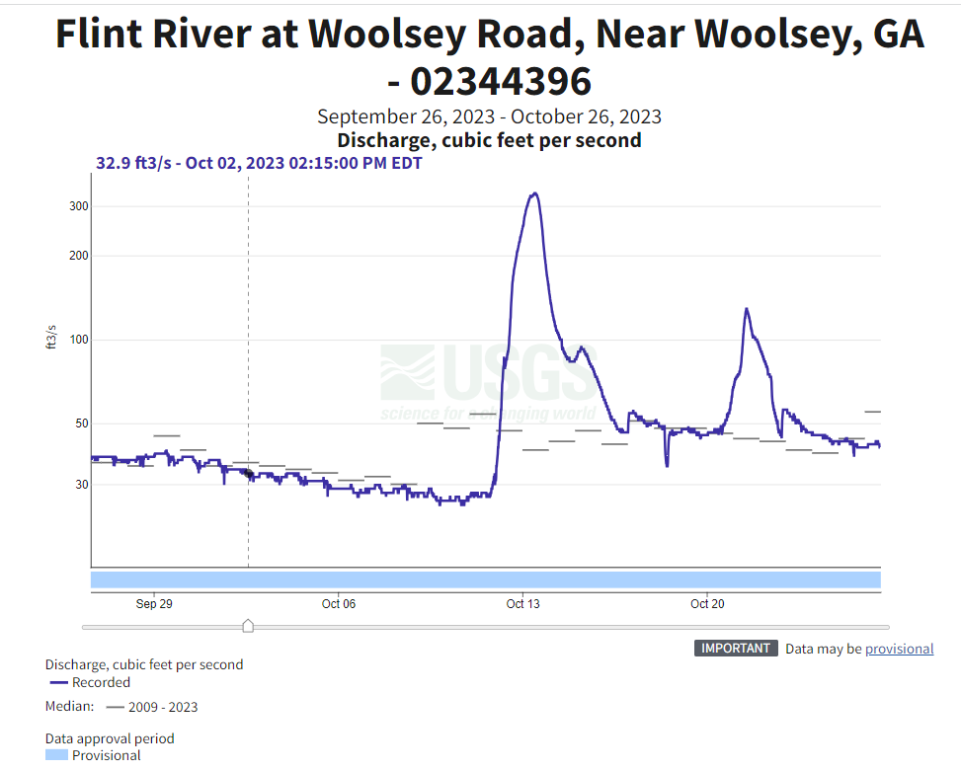
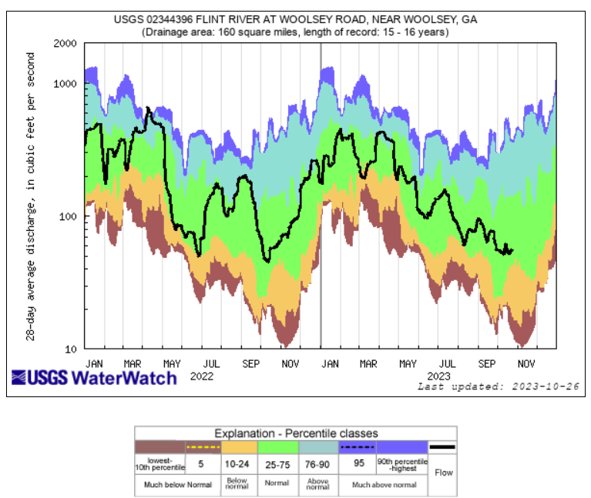

Slide 24
Next meeting: February 2024
District BAC Contact: Justine Schwartz, jschwartz@atlantaregional.org

