Slide 1
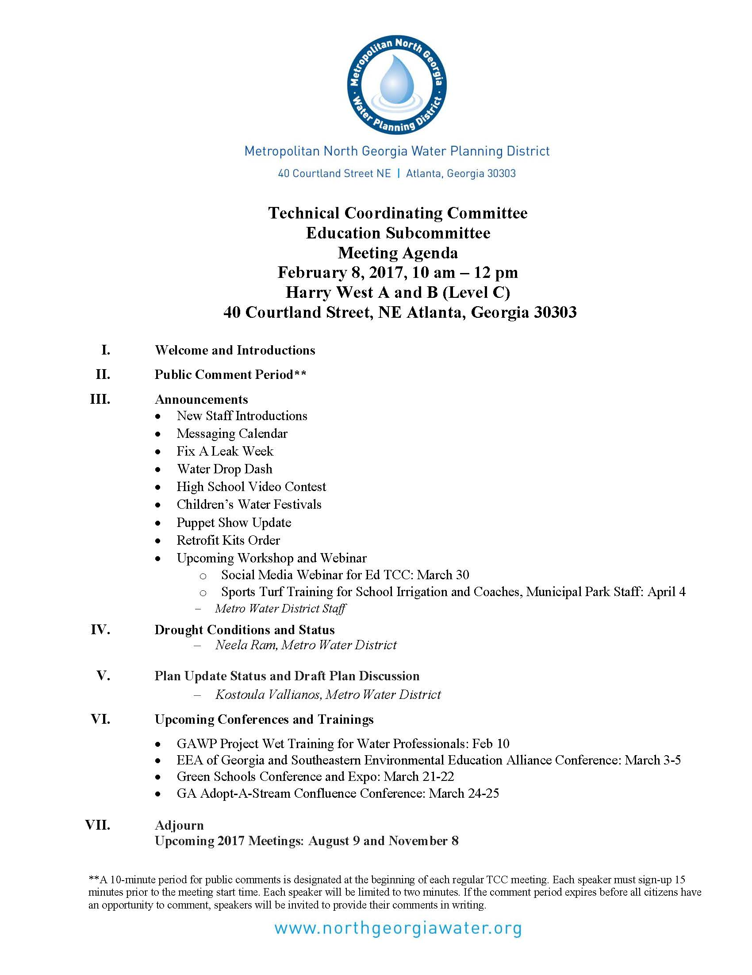

Slide 2
Metropolitan North Georgia Water Planning District 2017 DRAFT Water Resource Management Plan Review
February 8, 2017

Slide 3
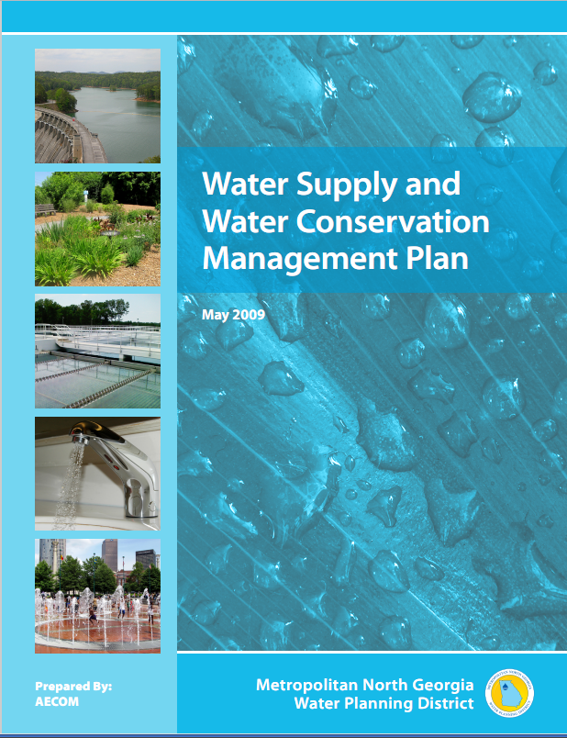
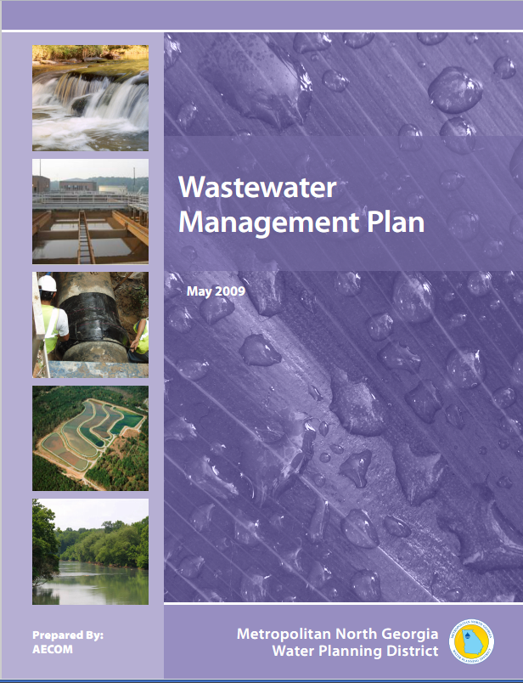
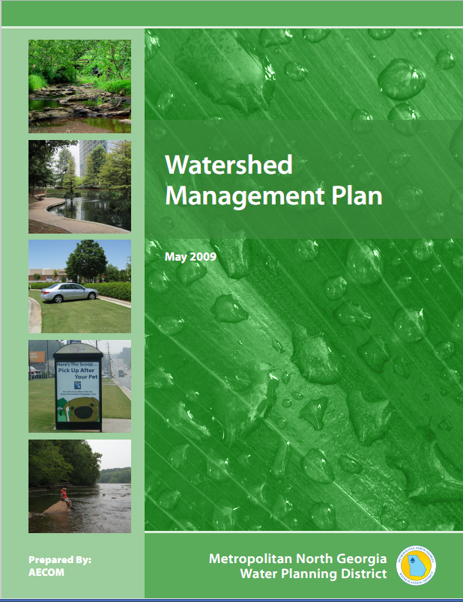
2017 DRAFT Water Resource Management Plan Review
Key Elements
Moving from three separate plans to one Integrated Management Plan
New, expanded and revised action items
Streamlining elements of Watershed Plan requirements

Slide 4
DRAFT Plan Outline
Introduction
Planning Principles and Management Challenges
Existing Facilities and Conditions
Future Conditions
Action Items
Plan Implementation and Future Plan Evaluation

Slide 5
DRAFT Plan Outline
Appendix A – River Basin Profiles
Appendix B – County Level Summaries
Appendix C – Local Public Education Programs: Activities, Key Education Focus Areas and Target Audiences

Slide 6
Section 1 Introduction
Overview of the District
Discussion of Integrated Regional Water Resource Planning
Key Changes in the Plan
Policy Goals

Slide 7
Policy Goals
Protect Water Quality and Public Water Supplies
Support Conservation and/or Demand Management
Support Economic Growth and Development
Equitably Distribute Benefits and Costs
Promote Public Education and Awareness
Facilitate Implementation
Improve Resiliency

Slide 8
Section 2 Planning Principles and Management Challenges
Specific planning principles defined
Maximizing use of existing sources and facilities
Increase water conservation and efficiency
Consider return flows
Appropriate use of reclaimed water
Others

Slide 9
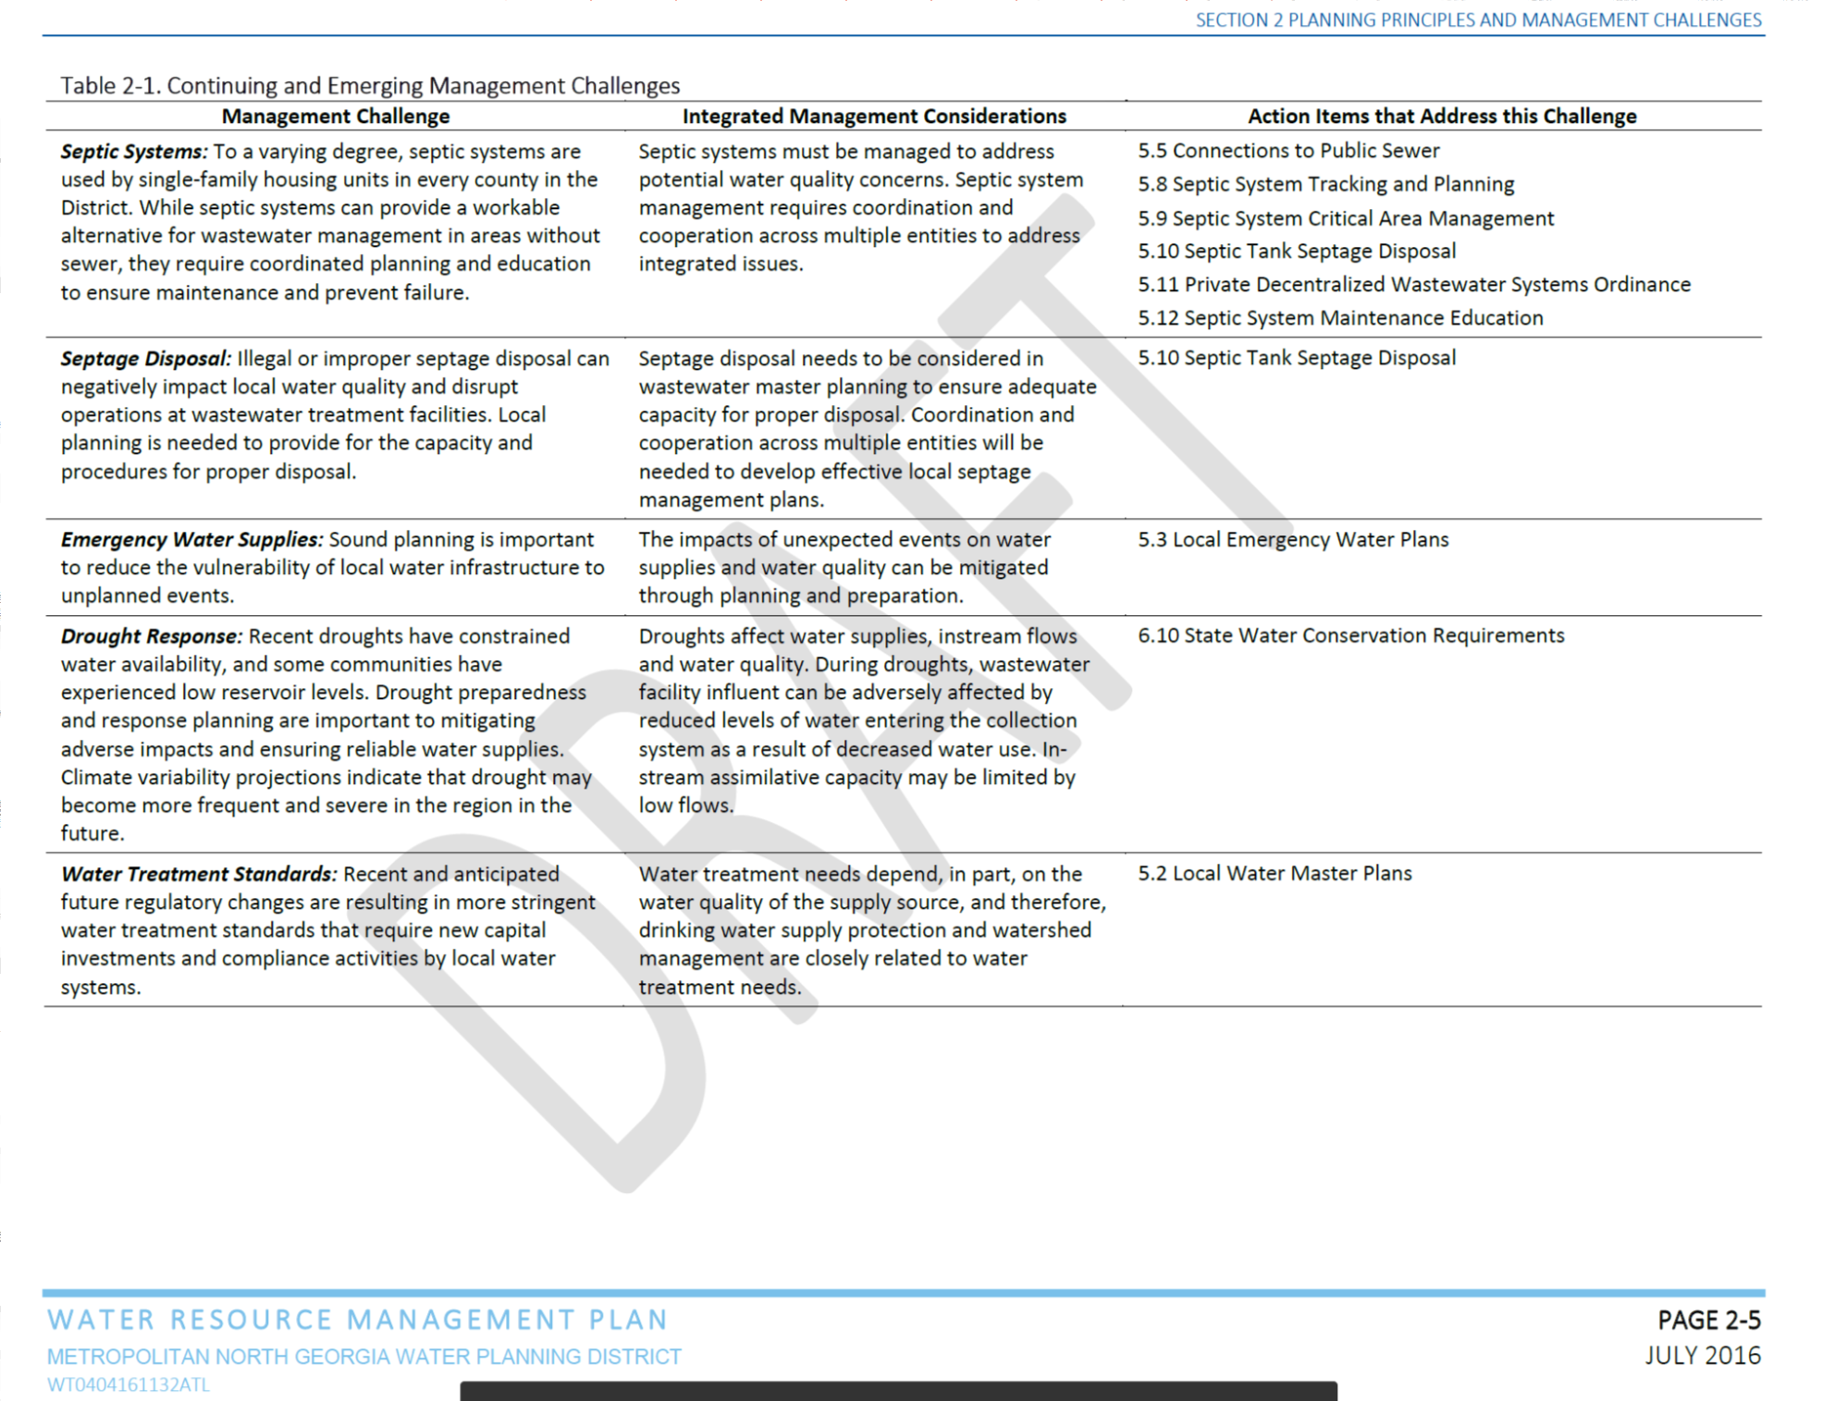
Section 2 – Planning Principles and Management Challenges

Slide 10
Section 3 Existing Facilities and Conditions
Water use trends
Permit capacities by system
Water conservation practices
Land use
Surface Water Quality

Slide 11
Section 4 Future Conditions
Population/employment forecasting
Water and wastewater demand forecasting methodology
2050 water/wastewater demand forecasts
2050 land use projections

Slide 12
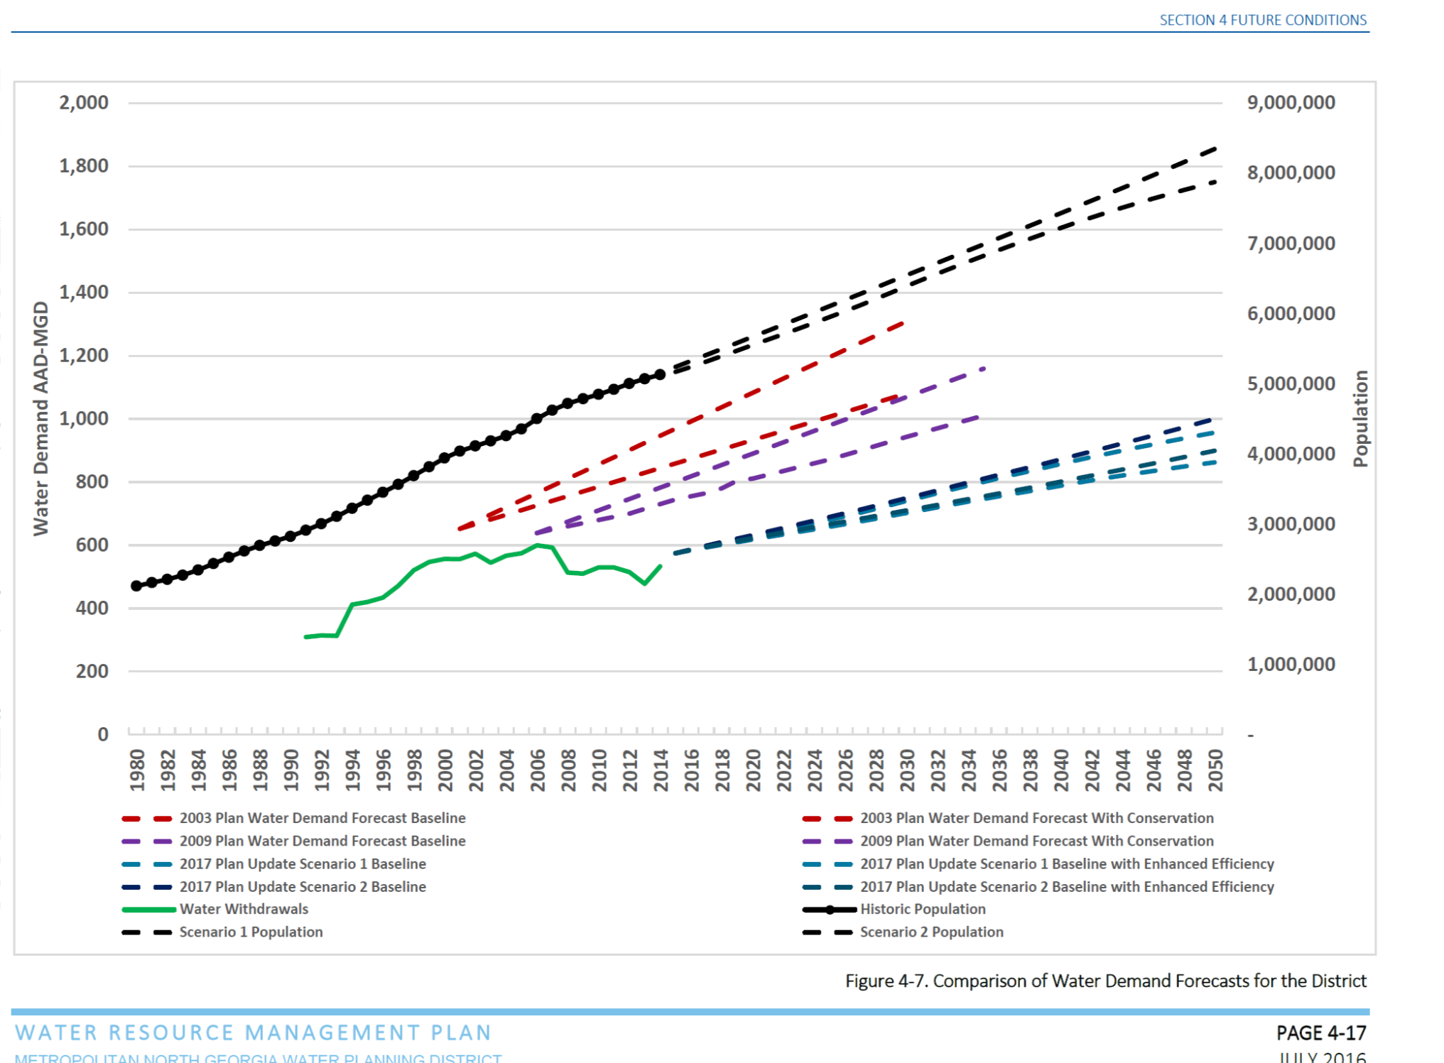
Section 4 Future Conditions

Slide 13
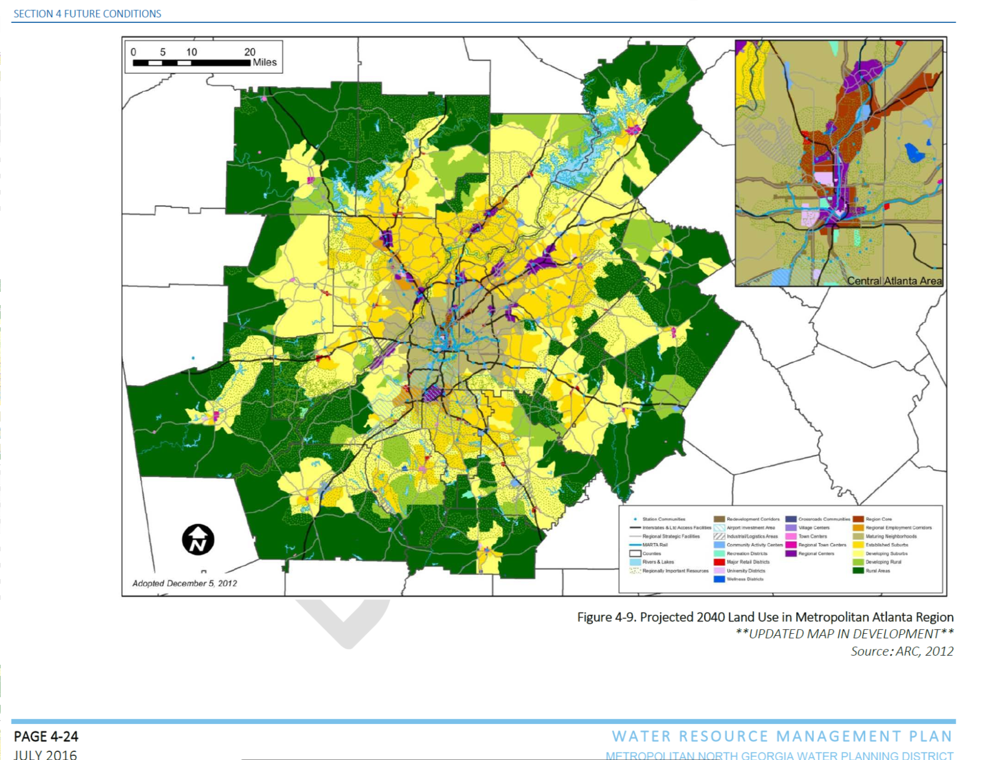
Section 4 Future Conditions

Slide 14
Section 5 Action Items
5.1 – Integrated
Highlights intergovernmental coordinated activities

Slide 15
Section 5 Action Items
5.2 – Water Supply and Water Conservation
Enhanced Water Conservation Program
Conservation program expansion
New commercial conservation programs

Slide 16
Section 5 Action Items
Build on existing programs
Expand and strengthen education and outreach initiatives
Expand measures that were previously basin-specific (multi-family toilet rebates, fire service lines)
Adopt water loss reduction targets
Expanded Commercial programs, including indoor and outdoor
Metering Private Fire Lines
Large Irrigation systems
Pre-rinse spray valves

Slide 17
Section 5 Action Items
5.3 - Wastewater
Improving reliability of infrastructure
Digital mapping requirements

Slide 18
Section 5 Action Items
5.4 - Watershed
Streamlined Action Items
Monitoring Elements (match the state reqs.)
Stormwater Management (MS4)

Slide 19
Section 5 Action Items
5.5 – Public Education
Provide best management practice case studies on Education programs
Updated Integrated Public Education and Outreach Plan Requirements
Minimum Requirements Tables
Education Focus for Target Audiences Table

Slide 20
Section 6 Plan Implementation and Future Plan Evaluation
Implementation
Technical Assistance Program
Funding and Financing Options
Future Plan Evaluation

Slide 21
Appendices
Appendix A – River Basin Profiles
Appendix B – County Level Summaries (Posted in late Jan)
Appendix C – Local Education Programs

Slide 22
Schedule
Feedback requested by February 17
Use EmailMe Form Link
Public Comment Period – Spring
District Plan Board Adoption – June 7

