Slide 1
Coosa BAC Meeting
November 9, 2023

Slide 2
Agenda
Tour with Finding the Flint
Announcements
2023 Water Reflections Calendar Contest Winners
Website Update and Walkthrough
2024 Water Drop Dash 5K
Water Supply Update
Flint & Ocmulgee Chair Elections

Slide 3
2023 Water Reflections Calendar Contest
Month-by-month winners

Slide 16
New District Website Features

Slide 17
Saturday, March 16, 2024 at the Chattahoochee Nature Center

Slide 19
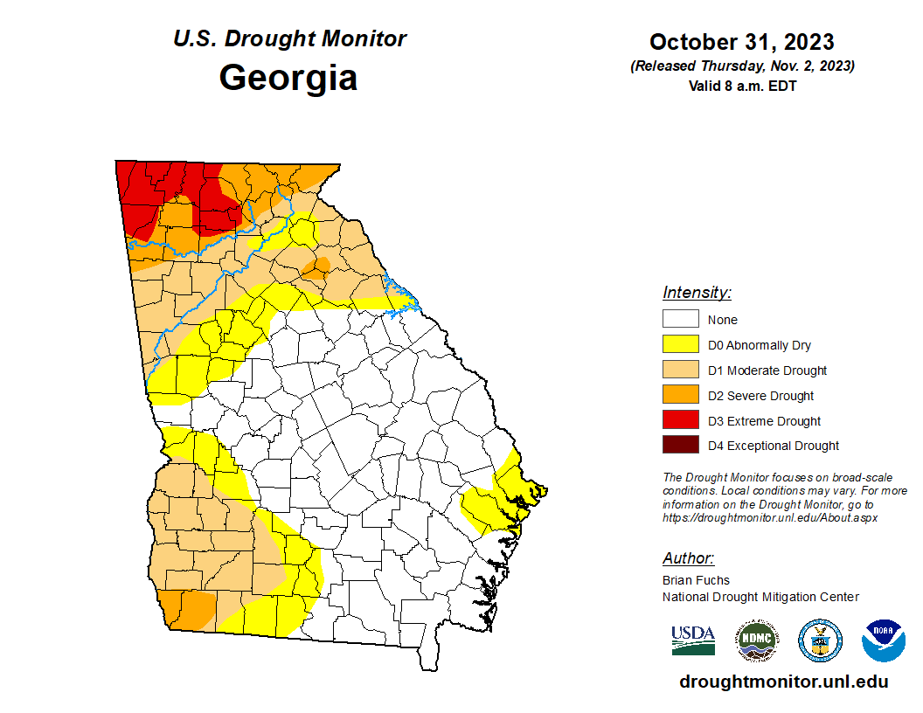
Drought Status

Slide 20
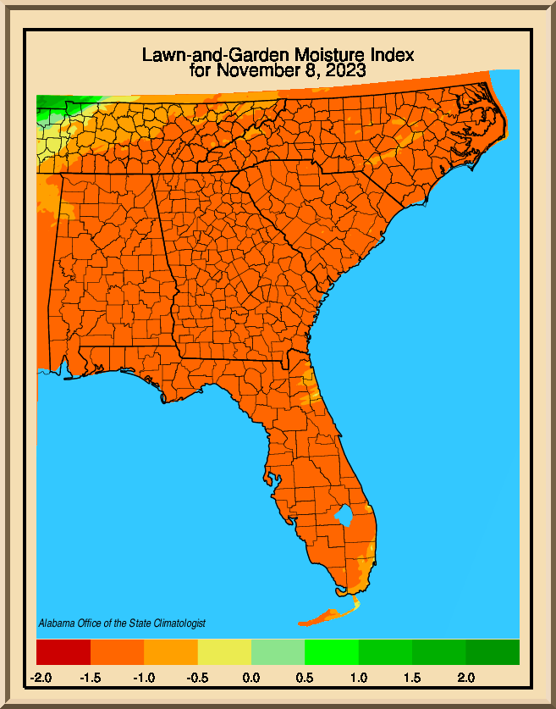
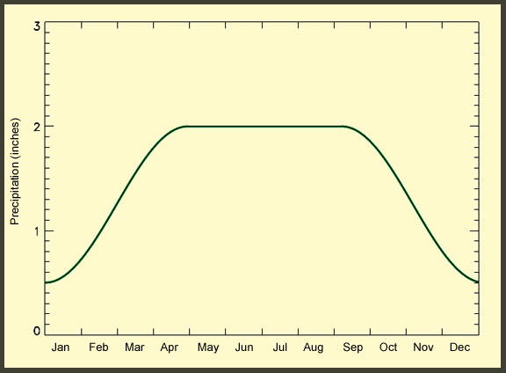
Moisture Index

Slide 21
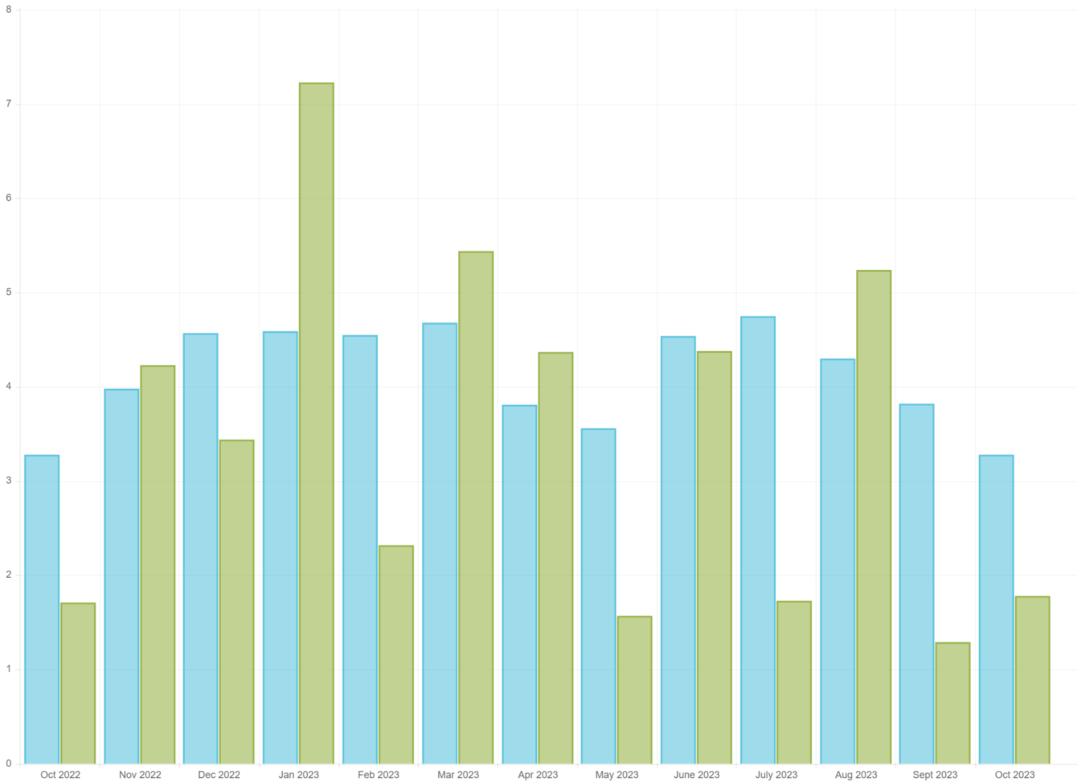
Rainfall in Metro Atlanta

Slide 22
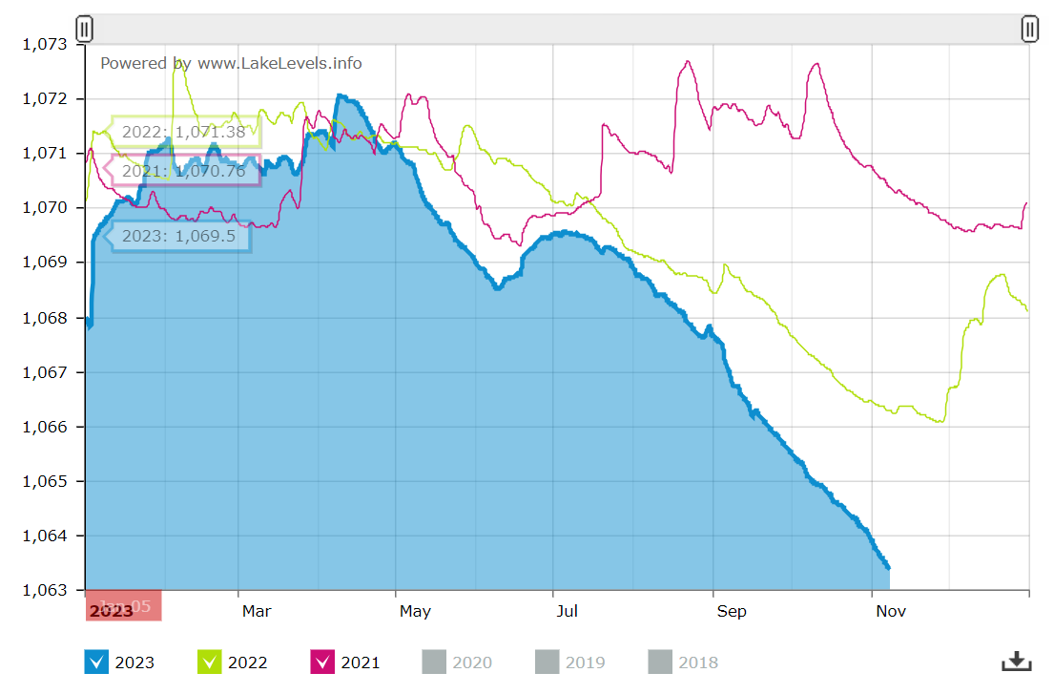
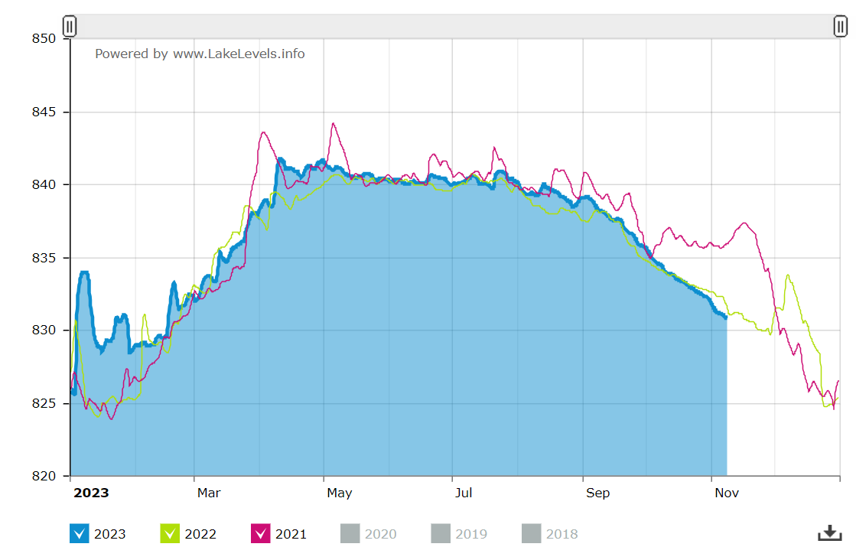
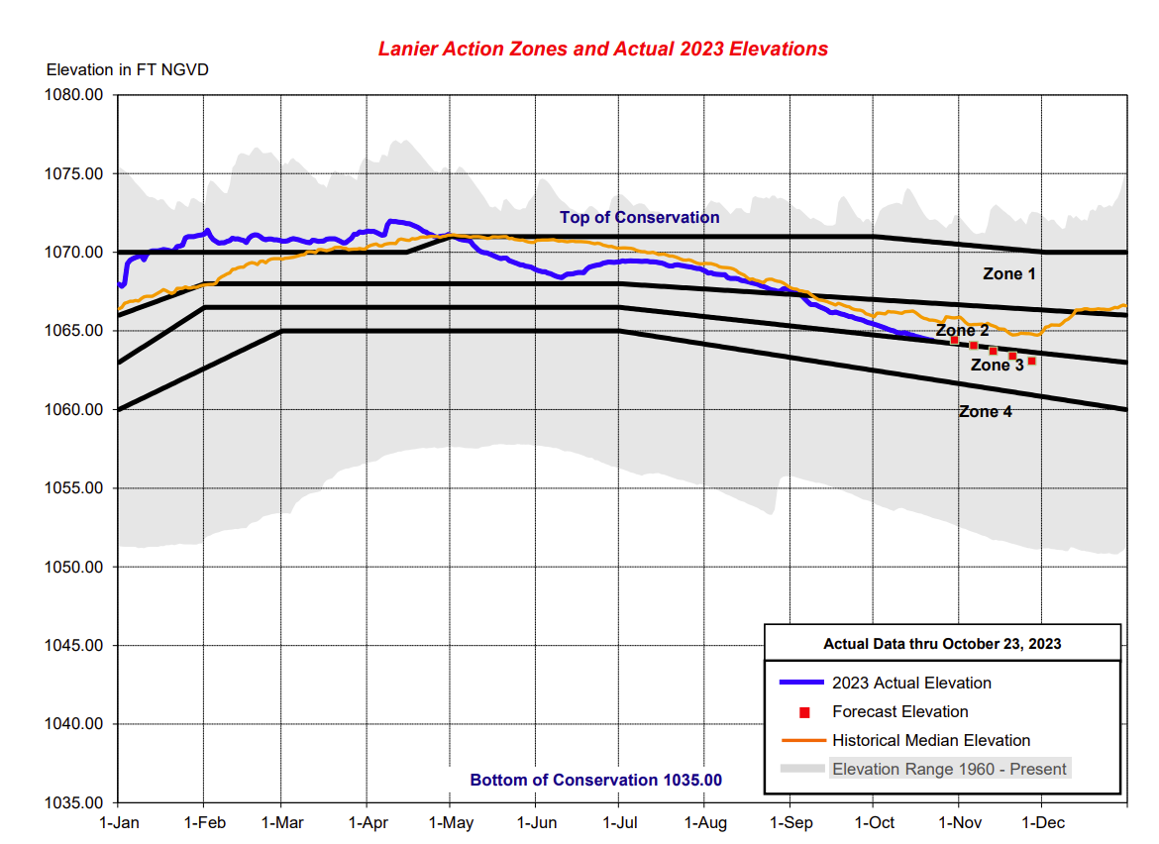
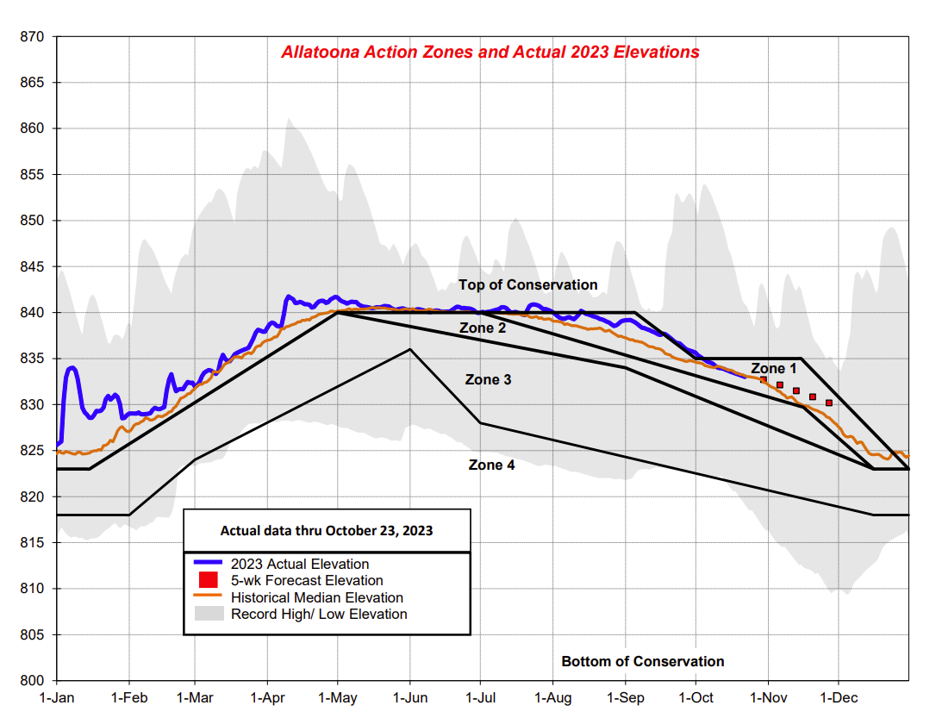
Lake Lanier (11/8)
1063.37’
Allatoona Reservoir (10/26)
830.80’
Full pool elev. – 1071’
Full pool elev. – 835’

Slide 23
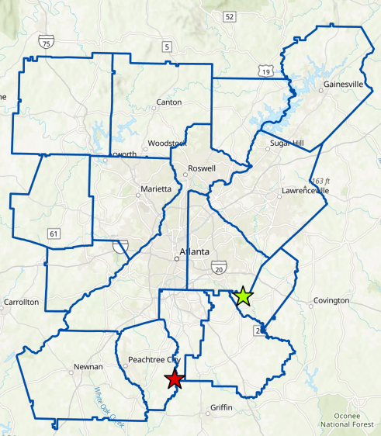
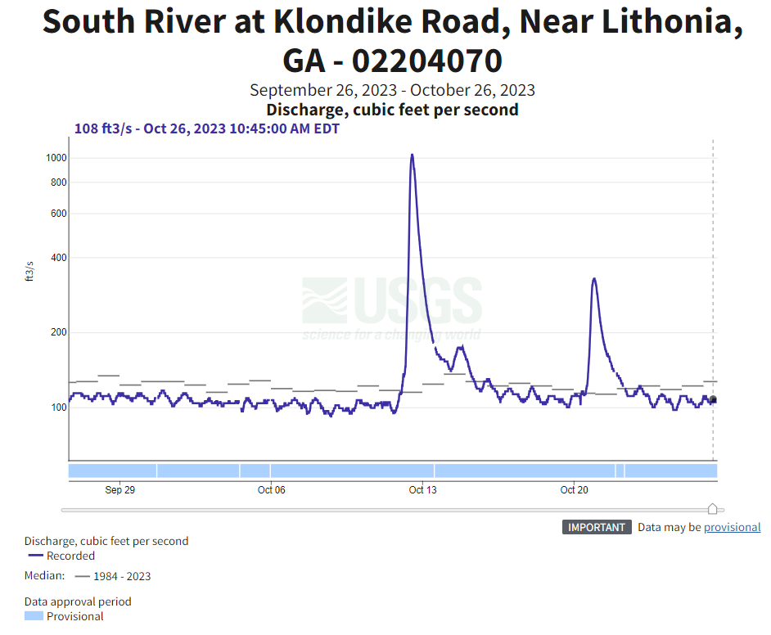
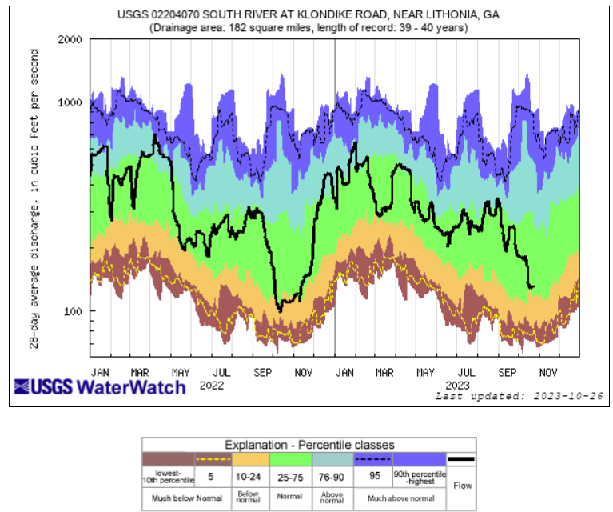
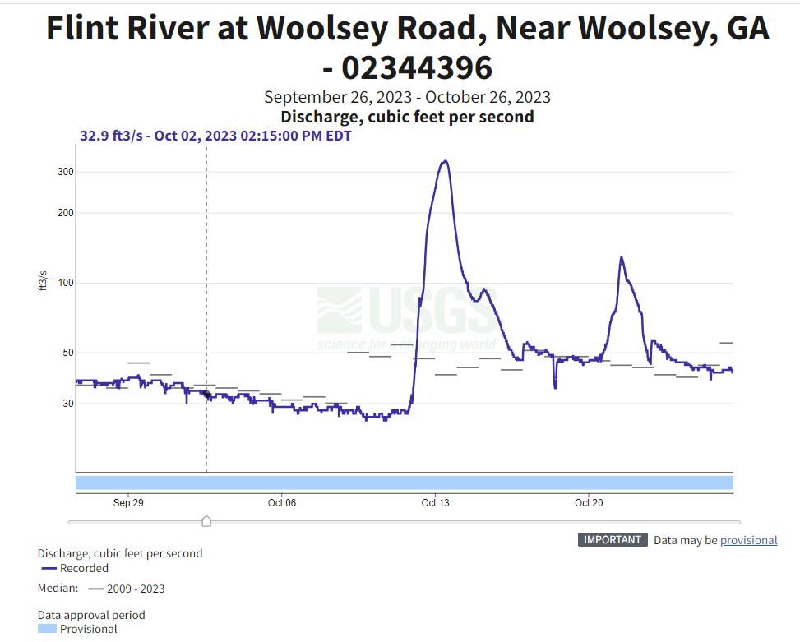
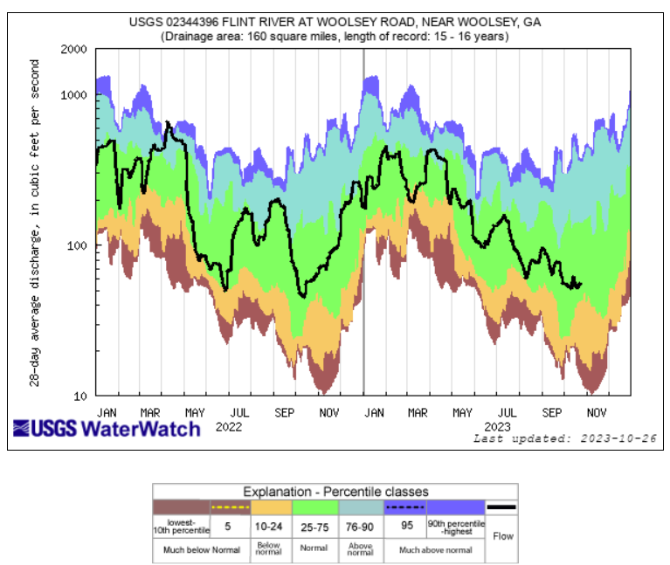

Slide 24
Developments of Regional Impact (DRI)

Slide 25
Next meeting: February 2024
District BAC Contact: Justine Schwartz, jschwartz@atlantaregional.org

